Slide 1
XLC Loader
DB Migration – Oracle to SQL Server

Slide 2
Types Of DB Migration
There are two types of migration
Schema Only
In this type of migration, only the database schema is created on the target database. For this purpose the script file is provided to execute on target SQL server which will create complete but empty database.
Schema and Data
In this type of migration complete Database is migrated from source server to destination server. It moves schema as well as Data from source server. This can be done by using “Import and Export Data” utility available with MS SQL server.

Slide 3
Schema Only
Please follow these steps to migrate the Schema only DB
Download the script files from the ftp location ftp://172.21.12.166/XLC/Scripts/
Open the SQL Server Management studio
Open file “1-CompleteDB.sql” in management studio and execute it.
It will create the complete DB on the SQL Server
Open file “2-Data scripts.sql” in management studio and execute it
It will insert configuration data like connections and templates etc into the XLC_ tables. This data is essential to execute the XLC Loader application.

Slide 4
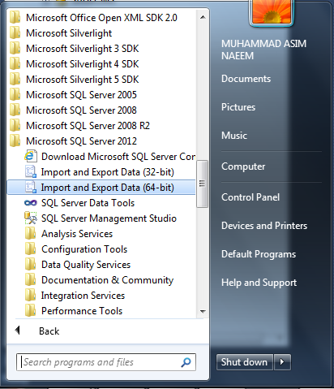
Schema and Data
Go to start menu
Expand Microsoft SQL server folder
Click on Import and Export Data option
Select 32 bit or 64 as per the Oracle client installed on the machine
The Import and Export data wizard will start.

Slide 5
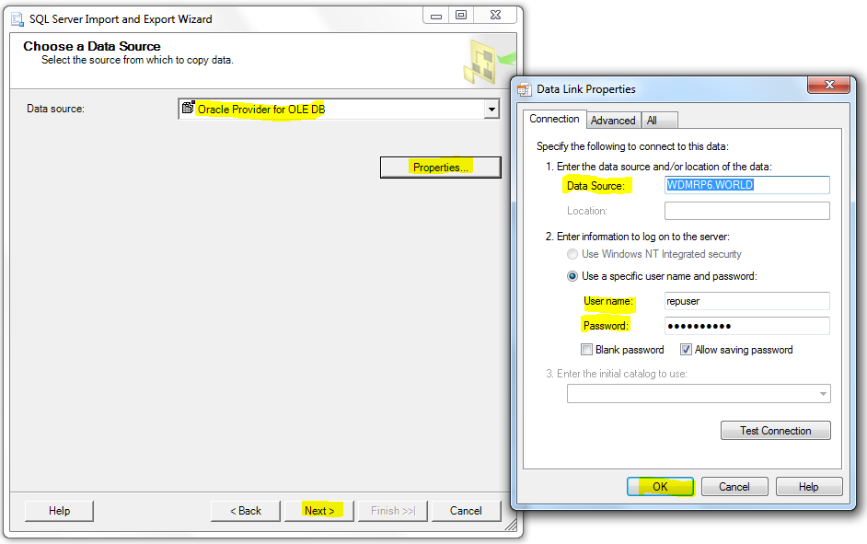
Schema and Data
Source Database – Oracle
Select appropriate data provider from Data source drop down list.
Click on “Properties” to open “Data Link Properties” dialogue box.
Enter the oracle database credentials like Data source, user name and password.
Click “Test connection” to test the connection to oracle database and then click “OK”.
Click “Next” button

Slide 6
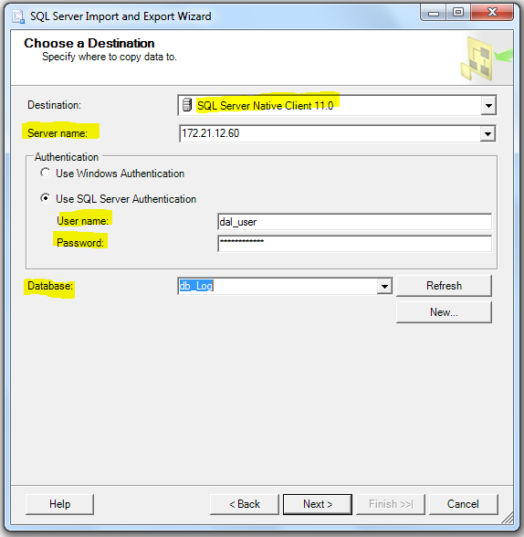
Schema and Data
Destination Database – SQL Server
Select the appropriate data provider from Destination drop down list.
Enter the destination server Name/IP
Enter the authentication credentials like user name and password
Select the target database name from database list.
Click “Next” to proceed.

Slide 7
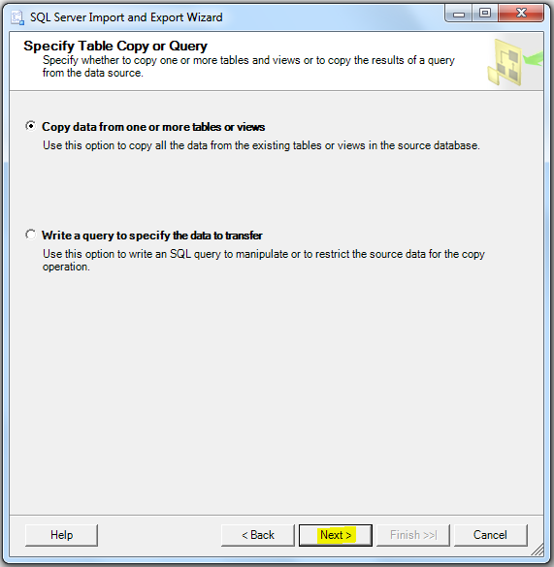
Schema and Data
Select the first option “Copy data from one or more tables or views”
Click “Next” button to proceed

Slide 8
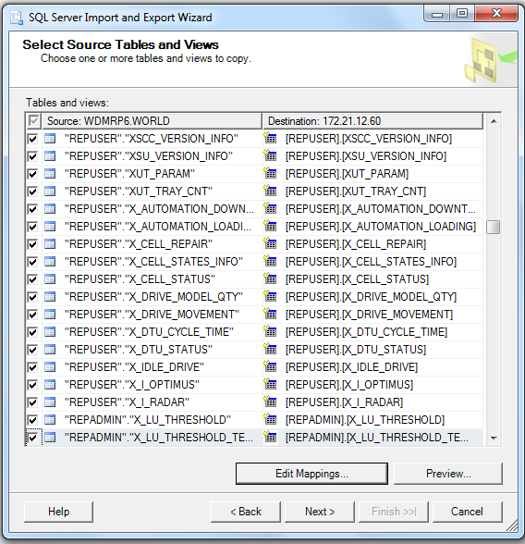
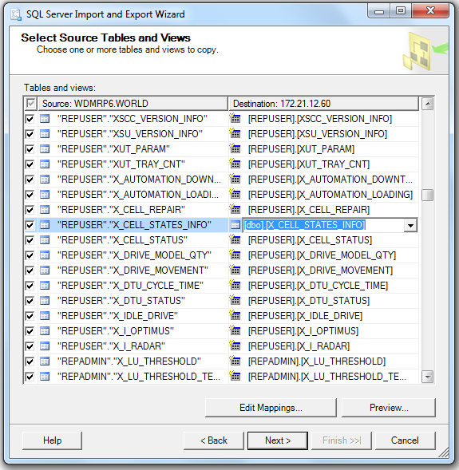
Schema and Data
Select the Table(s) needs to migrate from oracle server to SQL server.
Click on the destination Table name to edit the Name of the corresponding table in Destination Database Management system.
Click on Edit Mapping to open the mapping of columns of selected table.
After finishing all settings, click “Next” button to proceed to next step.

Slide 9
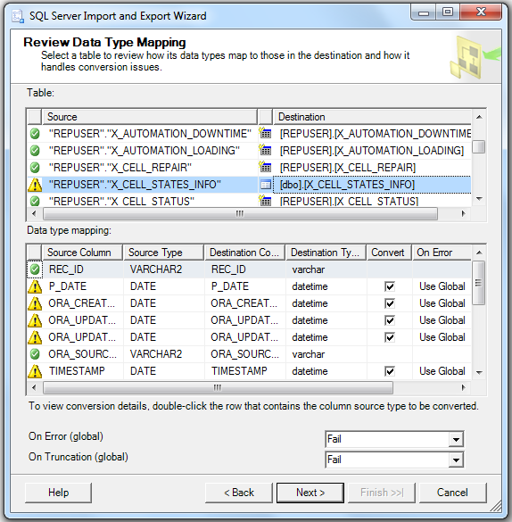
Schema and Data
Review data type mapping of each column of all selected Tables.

Slide 10
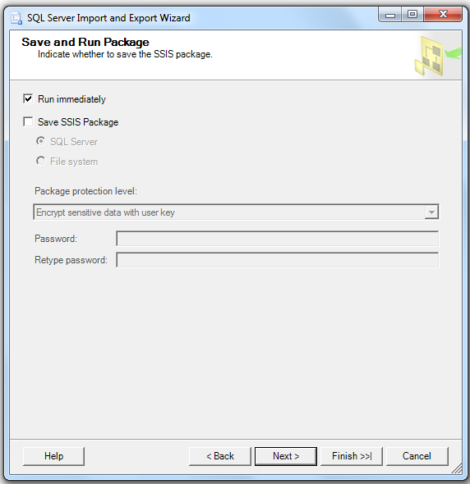
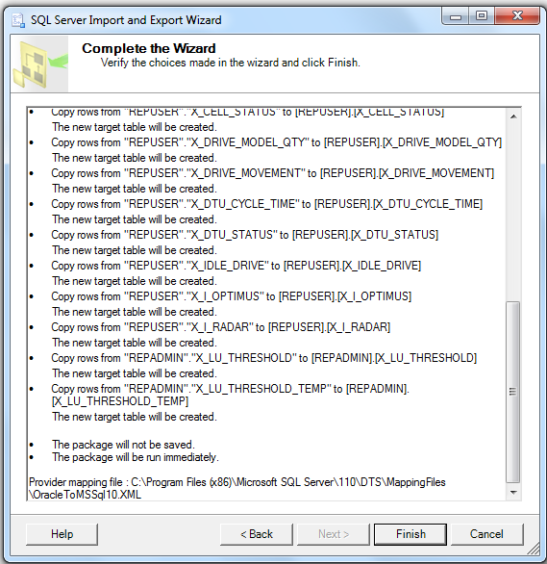
Schema and Data
Select the appropriate option either to run the activity immediately or to save as SSIS package to run later.
On the finish screen we can review all the activities performed by the wizard.
Click on “Finish” button to start the migration activity.

